Slide 1
Radio Broadcasting History
Ganesh Kumar Ranjan
Faculty, MJMC
MMHA&PU

Slide 2
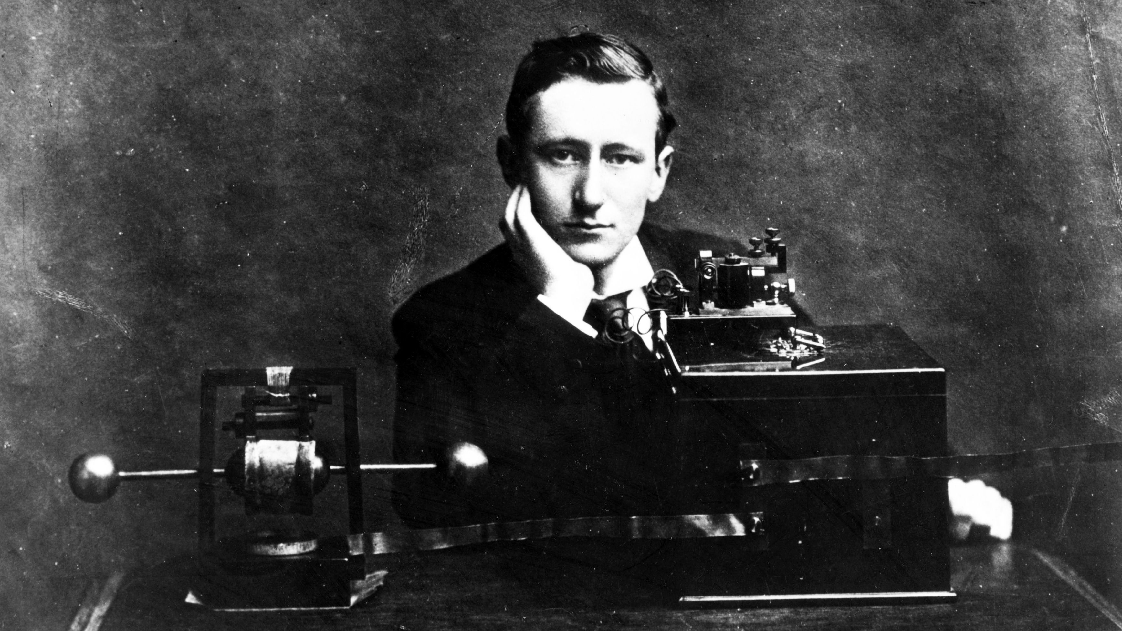
1893 – Nikolai Tesla demonstrated a wireless radio in St. Louis
1896 – Guglielmo Marconi patent wireless telegraphy in England, transmit signals across Atlantic Ocean
Prior to 1920s radio was primarily used to contact ships that were out at sea.
Guglielmo Marconi with his invention

Slide 3
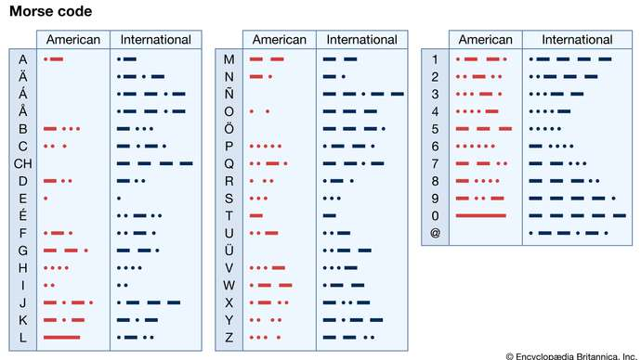
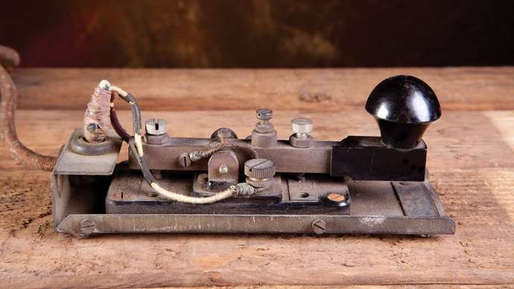
Morse code messages were used as electrical signals.
American-patterns-dots-International-Morse-Code-letters

Slide 4
The first radio station were set up in Pittsburg, New York and Chicago in 1920 to broadcast election news, sporting events and open performances.
1926 – National broadcasting Company(NBC)
A number of independent stations clubbed together to form Columbia Broadcasting System( CBS)
National Public Radio (NPR) established latter
1920 – BBC autonomous public service corporation

Slide 5
20 August 1921 – The Times of India broadcast was transmitted from the roof of its building at Bombay
1923 – The radio Club Of Calcutta(1st amateur radio club)
1924 - Madras Presidency Club
23 July 1927 - IBC ( Indian Broadcasting Company ltd)
01 March 1930 , IBC goes bankrupt.
April , government took over the company and renamed it as Indian Satate broadcasting services(ISBS).

Slide 6
Lionel Fielden – India’s first ontroller of Broadcasting
ISBS comes under Department of Industries and Labour
08 June 1936 – name of ISBS changed to All India Radio (AIR)
A.S. Bukhari appointed as Deputy Controller of Broadcasting.
1938 – Lucknow station started
24 october 1941- Departemnt of Information and Broadcsting established
1943 – the headquater of All India Radio shifted to red brick building of “Broadcasting House” at parliament street.

Slide 7
1946 – AIR transferred to the Department of Information and Broadcasting and remained untill 1997.
14- 15 August 1947 – AIR did live coverage of the function of transferring power from the central hall of the parliament .
12 November 1947 – Mahatma Gandhi comes to the Broadcasting House.
26 January 1948 – Patna station Started
1957- Vvidh Bharti started
The name of AIR changed to Akashwani. In english it is still called All India Radio.

Slide 8
1977 – the first FM transmission started from AIR Madras. Beginning of anew era.
23 November 1997 – PRASR BHARTI
2002 – Star group started Radio City.
2004 – advent of Direct to Home(DTH)

Slide 9
Creative to do –
Go through the link- https://doi.org/10.1017/S1356186307008048

